Slide 1

By Daniel, Alexandra, Veronika, Dayana
Project
about the USA

Slide 2

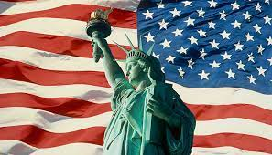
USA
The United States has a federal form of structure, administratively divided into 50 states and the Federal District of Columbia.

Slide 3
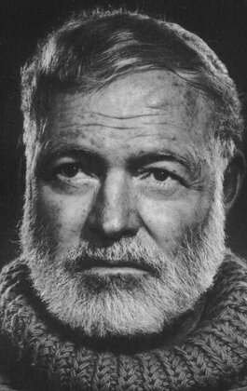
Ernest Miller Hemingway
Ernest Hemingway is an American writer, war correspondent, and the 1954 Nobel Prize for Literature laureate.
Hemingway received wide recognition thanks to both his novels and numerous stories - on the one hand, and his life, full of adventures and surprises, on the other.

Slide 4
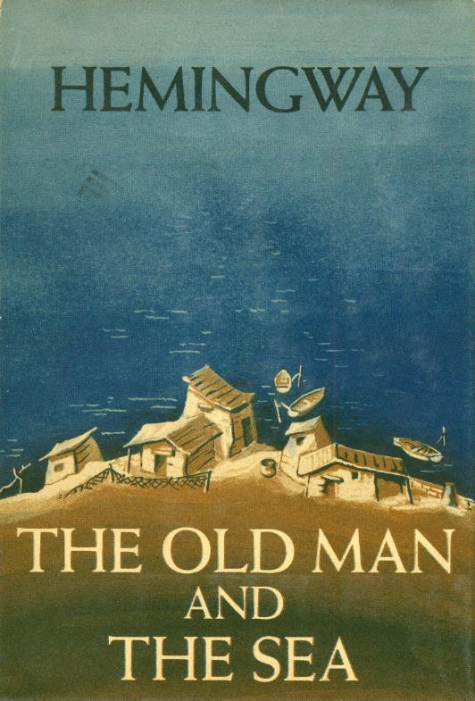
The Old Man and the Sea
"The Old Man and the Sea" is a novel by the American writer Ernest Hemingway, published in 1952. Hemingway's last known fiction to be published during his lifetime. No good book has ever been written in such a way that the symbols in it were invented and inserted into it ...
I tried to create a real old man, a real boy, a real sea, real fish and real sharks. But if I've done them well enough and truthfully enough, they can mean a lot

Slide 5
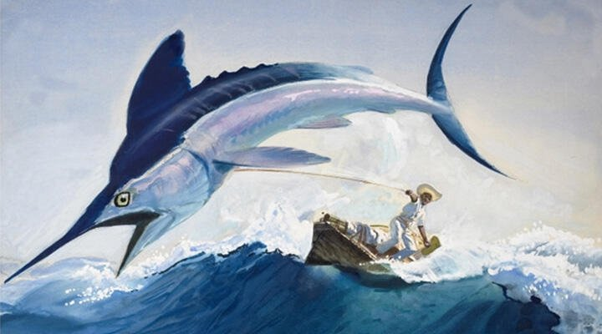
The Old Man and the Sea
Old man Santiago lives in a small fishing village in Cuba and fishes all alone. The last time he spent 84 days at sea, he did not catch anything. Previously, the boy Manolin was fishing with him, who helped the old man a lot,
but the boy's parents decided that Santiago was unlucky and told their son to go to sea in another boat. The old man taught Manolin to fish, and the boy loves Santiago, wants to help him. He buys him sardines for bait, brings food to his hut. The old man has long come to terms with his poverty.

Slide 6

Thanks for attention
we tried very hard

