Slide 1
English sounds
(vowels)
Yesimkanova Altyn Dauletovna
Karagandy

Slide 2
Aa

Slide 3
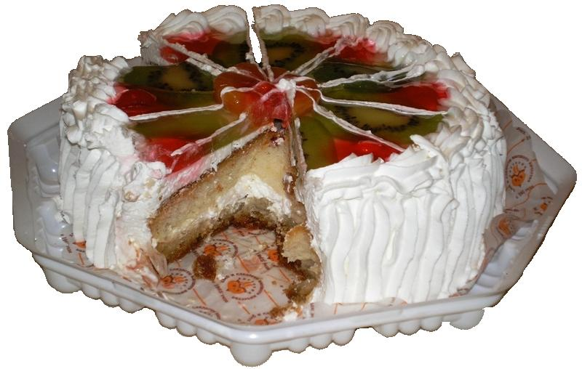

Slide 4
cake
[eI]

Slide 5
name
late
lake
game
plane
make

Slide 6
Ee

Slide 7
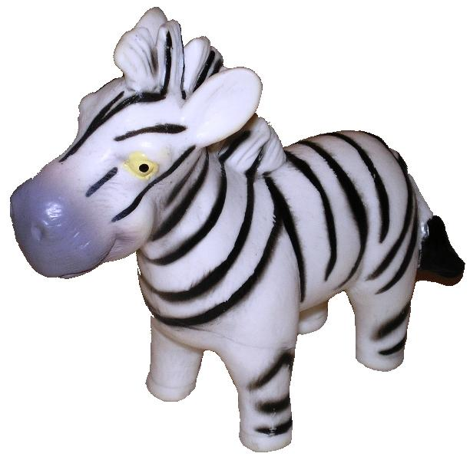

Slide 8
zebra
[J]

Slide 9
he
she
we
be
me

Slide 10
Ii/Yy

Slide 11
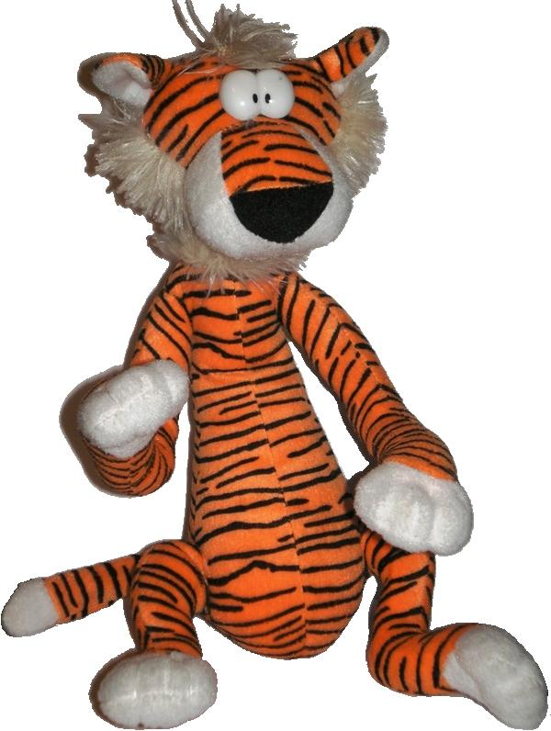

Slide 12
tiger
[ai]

Slide 13
time
type
my
mine
fly
fine

Slide 14
Oo

Slide 15
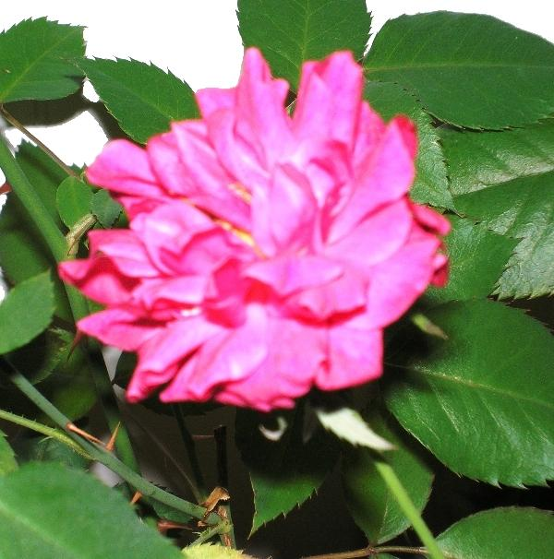

Slide 16
rose
[ou]

Slide 17
home
hope
note
nose
stone

Slide 18
Uu

Slide 19
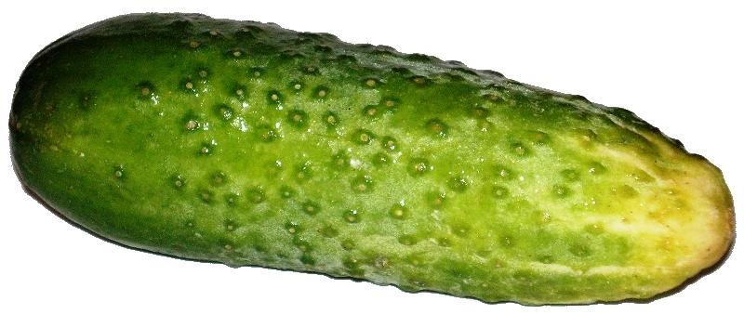

Slide 20
cucumber
[jH]

Slide 21
tune
student
use
human
pupil

Slide 22
Чтение гласных в открытом типе слога
Aa [eI] | Ee [J] | Ii/Yy [ai] | Oo [ou] | Uu [jH]
name | me | like | rose | tube
late | he | time | nose | human
lake | she | type | home | pupil
game | we | my | stone | use

Slide 23
Aa

Slide 24
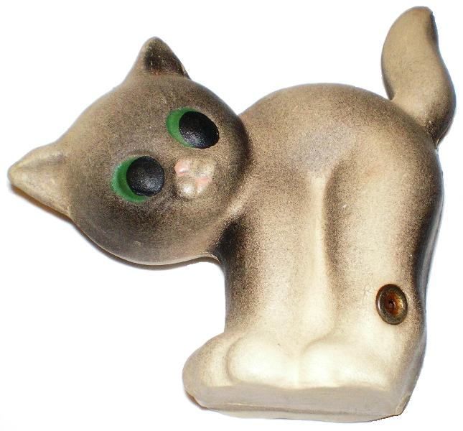

Slide 25
cat
[x]

Slide 26
tram
can
map
stand
plan

Slide 27
Ee

Slide 28


Slide 29
pen
[e]

Slide 30
get
egg
fell
let
ten

Slide 31
Ii/Yy

Slide 32
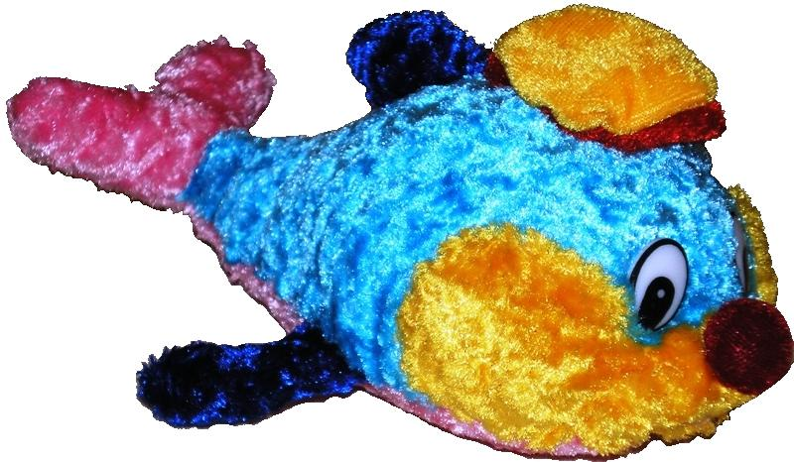

Slide 33
fish
[I]

Slide 34
it
ill
milk
wish
system

Slide 35
Oo

Slide 36
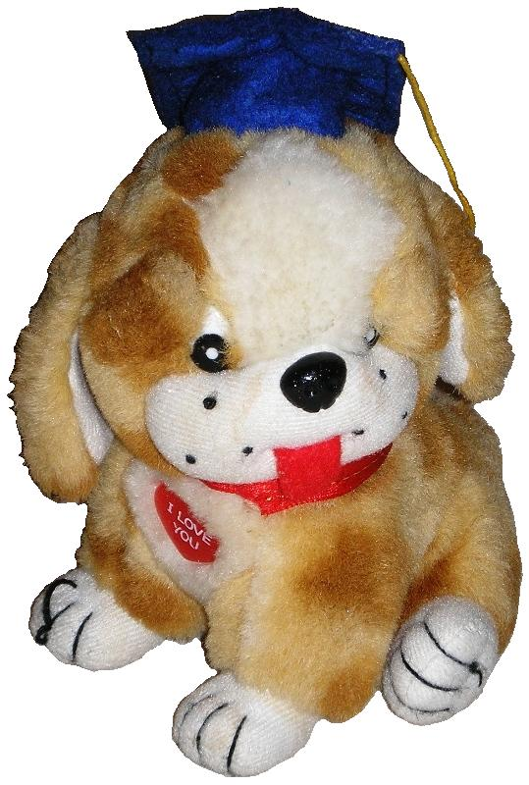

Slide 37
dog
[O]

Slide 38
not
clock
fond
shop
stop

Slide 39
Uu

Slide 40
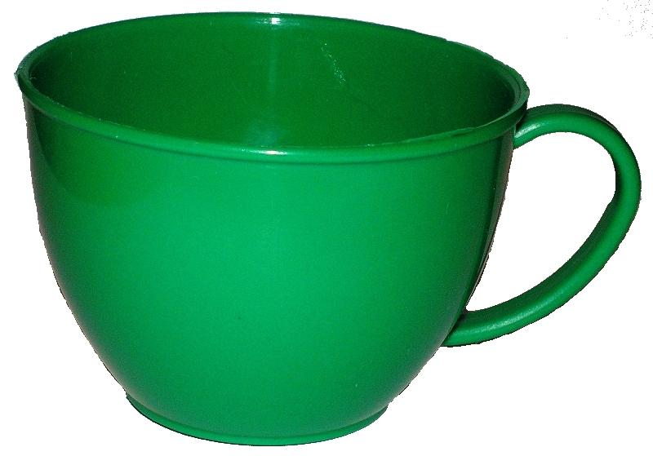

Slide 41
cup
[A]

Slide 42
fun
uncle
butter
supper
under

Slide 43
Чтение гласных в закрытом типе слога
Aa [x] | Ee [e] | Ii/Yy [I] | Oo [O] | Uu [A]
tram | get | it | dog | cup
can | egg | ill | not | fun
map | let | milk | hot | uncle
stand | ten | system | lot | butter

Slide 44
a+r

Slide 45
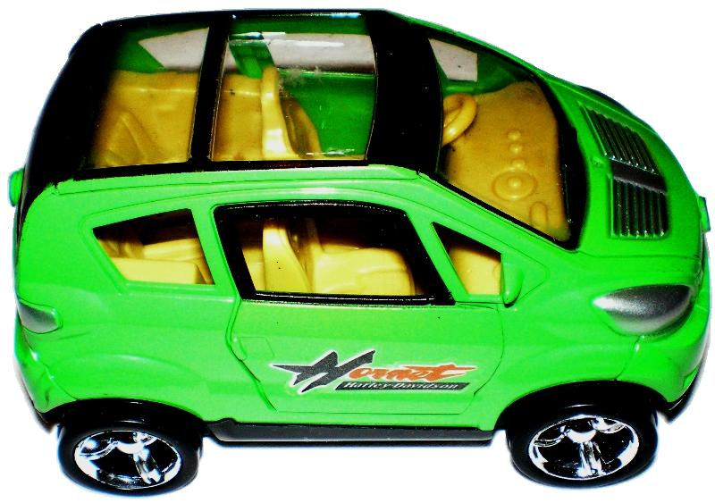

Slide 46
[R]
car

Slide 47
hard
dark
start
party
farm

Slide 48
e+r

Slide 49
verb
[W]

Slide 50
her
term
verb
serve
person

Slide 51
i/y+r

Slide 53
circle
[W]

Slide 54
sir
bird
girl
dirty
myrtle

Slide 55
o+r

Slide 56
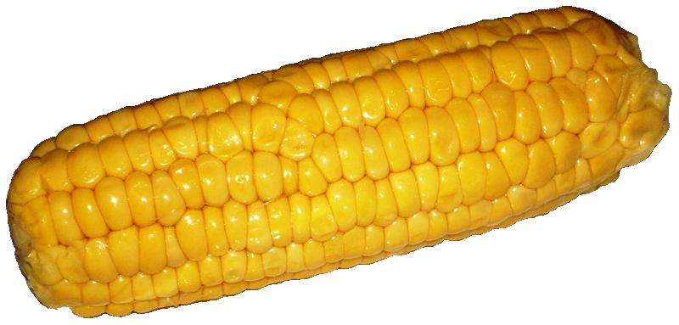

Slide 57
[L]
corn

Slide 58
or
nor
North
sport
lord
short

Slide 59
u+r

Slide 60
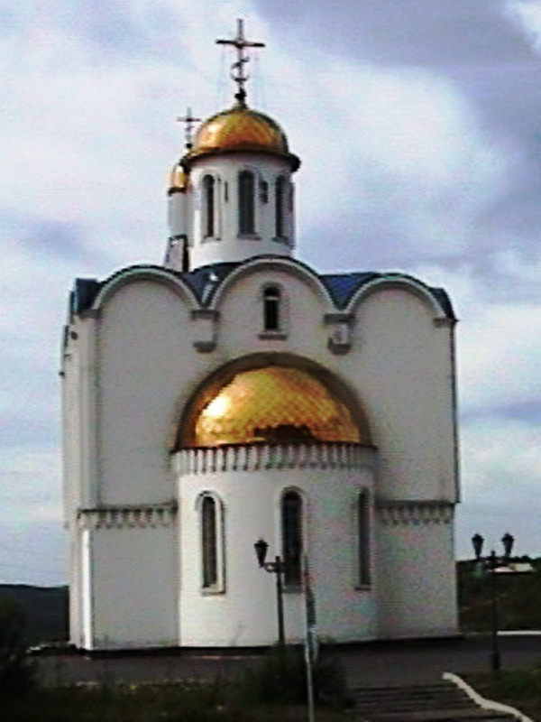

Slide 61
church

Slide 62
burn
turn
return
Turkey
furniture

Slide 63
Чтение гласных в третьем типе слога
a+r [R] | e+r [W] | i/y+r [W] | o+r [L] | u+r [W]
hard | her | sir | or | burn
car | term | bird | nor | fur
dark | verb | girl | North | curl
start | person | myrtle | short | turn

Slide 64
Все фотографии, использованные при оформлении работы, принадлежат Добряк С.Н.

